Slide 1


ABAP on Hana s/4 Hana Training
Day 15
contact@anubhavtrainings.com

Slide 2

Agenda – Day 15
CDS Table Functions
CDS-BOPF Integration
Describing Validation in ( Business Object ) BO
Implementation of Smart filter UX Application
Transactional UX App with CDS and BOPF

Slide 3
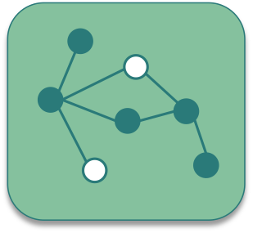
CDS Table Function
CDS Table Functions allow to use natively implemented database-functions in SAP HANA DB directly from CDS.

Slide 4

Why we need CDS Table Function
CDS is an open extension of classical DDIC views:
Support for AnyDB
Optimal integration into DDIC and ABAP
Supports about 90 % of SQL features
But: no access to specific HANA features
Required: Some scenarios require selective measure (“Breakout Scenario” for HANA-only applications)
Highest performance requirements e.g. with complex calculations
Use of database / analytical engine specific functions required
Open SQL and CDS views do not yet offer functionality to solve the problem

Slide 5
Necessary part of CDS Table Function
Table function definition
Parameter list
Return Parameter
Reference to implementing method
Runtime for table function
Runs stored SQL-script procedure generated from AMDP on database tables
ABAP Managed Database Procedure
SAP HANA Database
DDL Source
AMDP Implementation
Includes SQL-script function body

Slide 6


Key Feature of Table Function
They are implemented in HANA SQLScript via AMDP methods
Signature is defined in DDL source (importing parameters and return columns)
They can be consumed by Open SQL and ABAP CDS like other DDIC artifacts (i.e. DB tables, classical DDIC views, CDS views ...)
The SQLScript implementation is handled by the AMDP framework (lifecycle, tool support, extensibility etc.)
DDL source can be activated before the implementing AMDP method exists.
Exercise
CDS Table Function Code

Slide 7

CDS BOPF
The Business Object Processing Framework is an ABAP OO-based framework that provides a set of generic services and functionalities to speed up, standardize, and modularize your development. BOPF manages the entire life cycle of your business objects and covers all aspects of your business application development. Instead of expending effort for developing an application infrastructure, the developer can focus on the individual business logic. Using BOPF, you get the whole application infrastructure and integration of various components for free. This allows you to rapidly build applications on a stable and customer-proved infrastructure.

Slide 8
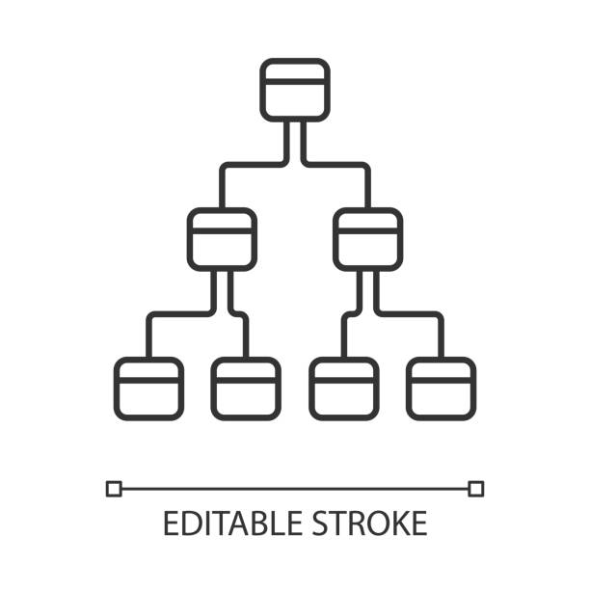
Business Object
The business objects are the basic units of the BOPF-based programming model. Business applications or processes operate on certain business objects.
A business object is represented as a hierarchical tree of nodes. A single node includes a set of semantically related business object data and the corresponding business logic.
On the technical level, each node is implemented with a regular Dictionary table, where each node instance corresponds to a single table entry (table rows).
Nodes, attributes, and alternative keys set up the data part of a business object. Again from a technical viewpoint, attributes form the columns of the table. A node serves as an anchor point for connecting the business logic of the business object.
For each node, several types of entities can be defined to form the specific business logic part of a business object.

Slide 9
Node of Business Object
Node Entity ...is used...
Action
... to implement a service (operation or behavior) of a business object. An action is explicitly triggered by a service consumer, such as the user interface.
Determination
... to provide functions that are automatically executed as soon as certain trigger conditions are fulfilled. A determination is triggered internally due to changes made to the instance of a business object.
Validation
... to either validate whether a specific action can be executed on a specific node instance (action validations) or whether a set of node instances is consistent (consistency validations).
Query
... to search for business object instances that meet certain search criteria.
Authorization Check
... to provide an authorization concept for BO nodes (for their data and for the operations on their data).
Association
... to connect business object instances that are located on different nodes.

Slide 10
Flow of BOPF Scenario
Metadata Extension CDS View.
Consumption CDS View.
Table – ZOFT_MEALS.
Draft Table - ZOFT_JUL_MEAL.
ZOFT_JUL_MEAL
ZOFT_MEALS
ZMAR_CDS_BOPF
ZMAR_MED_BOPF

Slide 11
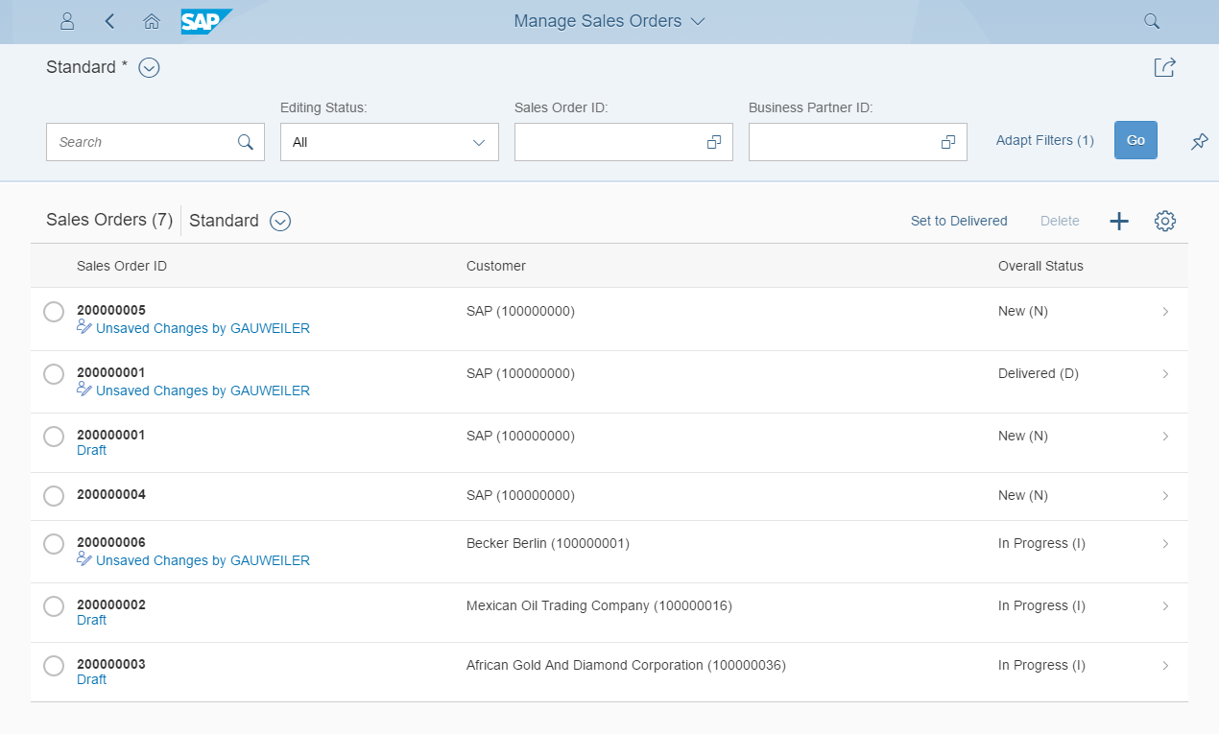
Development flow & Artifacts
BOPF (Business Object Processing Framework) is a framework for working with the BO (Business Objects). BO is a representation of a type of uniquely identifiable business entities described by a structural model, an internal process model, and one or more service interfaces.
consume
SAP Fiori Elements, …
OData Service
Consumption view
ption view
Search Object(s)
Core Data Services
generate / publish
Subnode consumption view
Subnode consumption view
Subnode consumption view
Subnode consumption view
Metadata Extension
enrich
Data Definition
BOPF Business Object
generate
implement
Custom ABAP Business Logic
CDS metadata extensions can currently only be created for CDS views. A CDS metadata extension is a CDS object that is defined and transported in a separate CDS source code.
Draft table
Database table
Draft table
Draft table

Slide 12
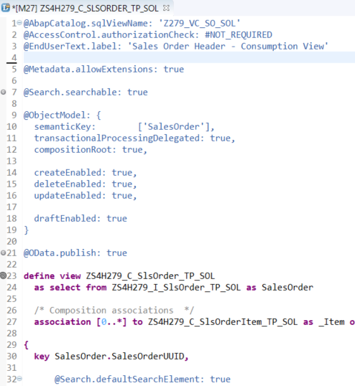
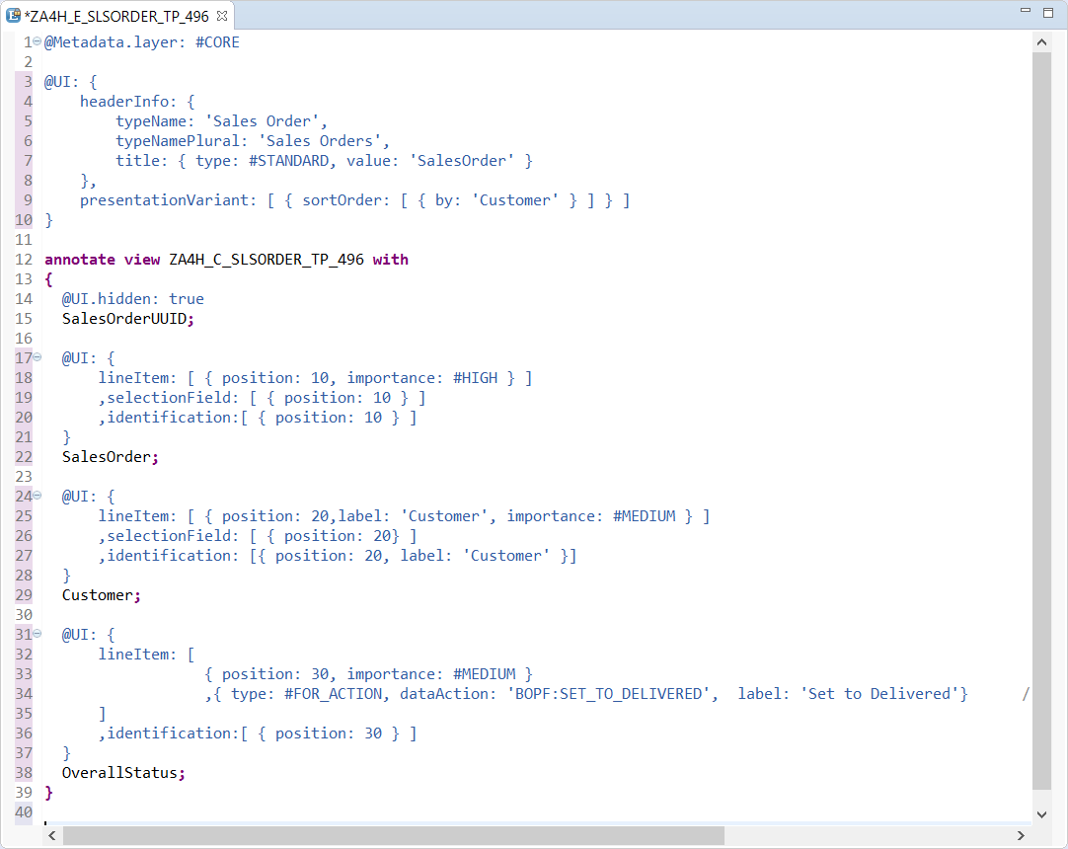
CDS Annotations
Access Control
UI semantic
Search enablement
Transactional enablement
OData exposure

Slide 13

Exercise
CDS BOPF Scenario

Slide 14

End of Day 15
Trainer: Anubhav Oberoy

Slide 15

Trainer: Anubhav Oberoy

Slide 16
THANK YOU
If you cannot do
great things, do small things in a great way.
Anubhav Oberoy
https://www.anubhavtrainings.com

Slide 17


We’re committed to empower you to be
Most Desirable Resource
through powerful training solutions.
We build the workforce of the future.
250+
Corporate Clients
30,000+
Learners Trained
25000+
Learners Placed
FREE WEBINARS
Sign up for free webinars with industry experts every fortnight!
Enroll Now!
Contact us today!
https://anubhavtrainings.com/

Slide 18




More from AnubhavTrainings.com

